Slide 1

Phishing Awareness Training
Safeguarding Our Digital Future: Practical Steps to Protect Yourself from Cyber Scams.
Notes:
1

Slide 2


What is Phishing?
Phishing is a deceptive cyber-attack where criminals impersonate trusted entities through fake emails, messages, or websites. Their primary goal is to trick individuals into revealing sensitive information, such as passwords, bank details, or personal data.
In 2024, over 80% of cyberattacks on Indian businesses involved phishing scams, highlighting the pervasive threat.
Notes:
2

Slide 3




Common Types of Phishing Attacks
Email Phishing
Spear Phishing
Deceptive emails appearing to be from legitimate sources, designed to trick recipients into revealing information or clicking malicious links.
Highly targeted and personalised attacks that use specific information about the victim, often gathered from social media or company websites.
Smishing & Vishing
Website Spoofing
Phishing attempts conducted via SMS texts (Smishing) or phone calls (Vishing), often creating a false sense of urgency or fear to manipulate victims.
Creating fake websites that closely mimic legitimate ones to steal login credentials, financial details, or other sensitive user data.
Notes:
3

Slide 4


How to Recognize Phishing Emails
Examine Sender’s Domain
Always scrutinise the sender’s email address. Look for subtle misspellings or unusual domain extensions (e.g., @bankofindia.com vs @bank0findia.com).
Spot Language Anomalies
Be wary of poor grammar, spelling mistakes, or overly urgent, threatening, or emotional language designed to create panic.
Verify Links Before Clicking
Hover your mouse over any hyperlinks to reveal the true URL. If it doesn’t match the expected address, do not click.
Beware of Unexpected Attachments
Exercise caution with unexpected attachments or unsolicited requests for confidential information like OTPs or passwords.
A typical phishing email often features a generic greeting, urgent language, and suspicious links.
Notes:
4

Slide 5
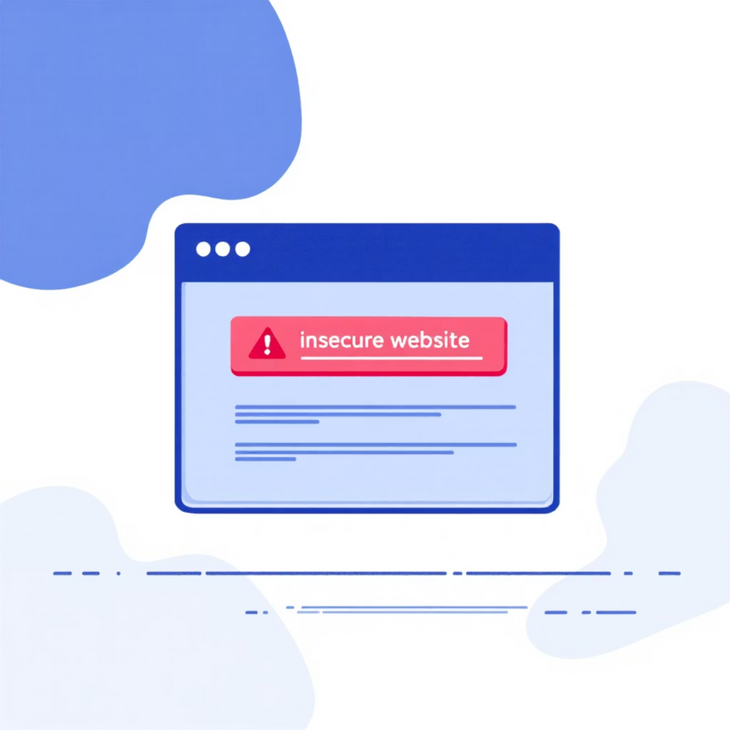
Spotting Fake Websites
Even trusted elements like HTTPS can be mimicked. Always maintain a critical eye.
HTTPS & Padlock Icon
While necessary, the presence of HTTPS and a padlock icon alone isn't a guarantee of authenticity, as some phishing sites now use them.
Inspect the URL
Carefully check the entire URL for any subtle misspellings, extra words, or unusual subdomains that might indicate a spoofed site.
Browser Warnings
Pay attention to browser warnings like "Connection Not Private" or "Deceptive Site Ahead." Never proceed if you see such alerts.
Manual URL Entry
If in doubt, avoid clicking links from emails or messages. Instead, type the official website address directly into your browser.
Notes:
5

Slide 6


Social Engineering Tactics Attackers Use
Cybercriminals manipulate human psychology to bypass security measures. They exploit trust, curiosity, and fear to achieve their objectives.
Creating Urgency/Fear
Impersonating Authority
Attackers create a sense of immediate danger or consequence (e.g., "Your account will be locked!", "Urgent action required!") to rush your decision-making.
They pose as CEOs, government officials, IT support, or other trusted figures to demand action or sensitive information, leveraging your respect for authority.
Leveraging Personal Details
Pretexting
Information gleaned from social media or public records is used to build a false sense of familiarity and trust, making the scam more convincing.
Inventing elaborate but believable scenarios or fake stories to persuade victims to divulge information or grant access, such as a "security check" or "account verification."
Notes:
6

Slide 7

Real-World Example: The 2023 Indian Bank Scam
In 2023, numerous Indian bank customers fell victim to a sophisticated phishing campaign. Attackers sent fake emails that convincingly mimicked official alerts from the Reserve Bank of India (RBI) or various commercial banks.
These emails often contained urgent messages, prompting users to "verify their accounts" or "update KYC details" by clicking on malicious links that led to spoofed banking portals. Before the scam was widely identified and warnings issued, over ₹5 crore was reportedly lost by unwitting individuals.
Key Lesson: Always verify any suspicious message or request via official and independently obtained contact information (e.g., calling your bank's official helpline, not the number provided in the suspicious email).
This incident underscores the importance of verifying all communications through official channels.
Notes:
7

Slide 8




Best Practices to Stay Safe
Adopting these simple yet crucial habits can significantly reduce your risk of falling victim to phishing attacks.
Never Share Credentials
Enable Multi-Factor Authentication (MFA)
Implement MFA wherever possible. It adds an extra layer of security, making it much harder for attackers to access your accounts even if they steal your password.
Authorised entities will never ask for your passwords, OTPs, or PINs via email, SMS, or phone calls.
Keep Software Updated
Report Suspicious Activity
Immediately report any suspicious emails, messages, or calls to your organisation’s IT or security team. Your vigilance helps protect everyone.
Regularly update your operating systems, web browsers, and antivirus software. These updates often include critical security patches.
Notes:
8

Slide 9
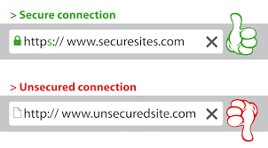
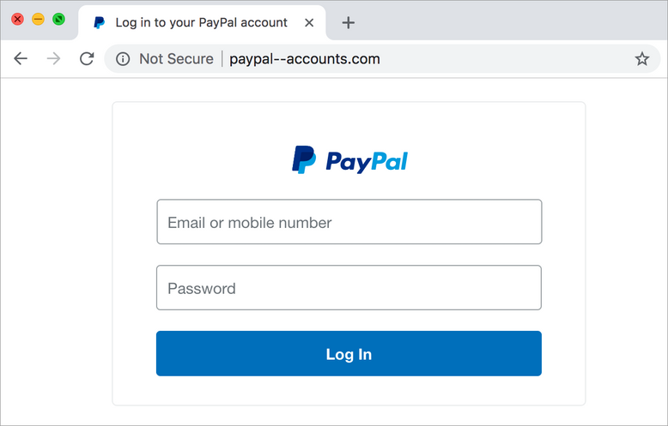

Interactive Quiz: Spot the Phish!
Let's test your phishing detection skills. Examine the following examples and decide if they are legitimate or potential phishing attempts.
Question 1: Is the email on the left phishing or safe? Consider the sender, language, and call to action.
Question 2: Would you trust the website on the right? Look closely at the URL and any visual inconsistencies.
(In a live presentation, answers would be revealed and explained, highlighting key indicators for detection.)
Notes:
9

Slide 10
Your Role in Cybersecurity
Phishing attacks are designed to exploit human trust, making each of us a potential target. Your awareness and vigilance are the strongest lines of defence against cybercriminals.
Stay Alert!
Continuous learning about the latest threats and applying best practices not only protects you but also fortifies the security posture of our entire organisation.
Remember: When in doubt, don’t click, verify!
Thank you for your attention. Any questions?
Notes:
10

Slide 11
Thank you

